Slide 1

Financial Fraud Detection
Identifying and Preventing Financial Fraud
Developed By: Aditya Singh

Slide 2





Presentation Overview
Introduction
Executive Summary
Analysis
Problem context and fraud detection fundamentals
Project methodology and key findings overview with benefits
Exploratory analysis and pattern insights
Model Evaluation
Conclusions & Key Insights
Performance metrics and algorithm comparison
Strategic implementation and next steps

Slide 3

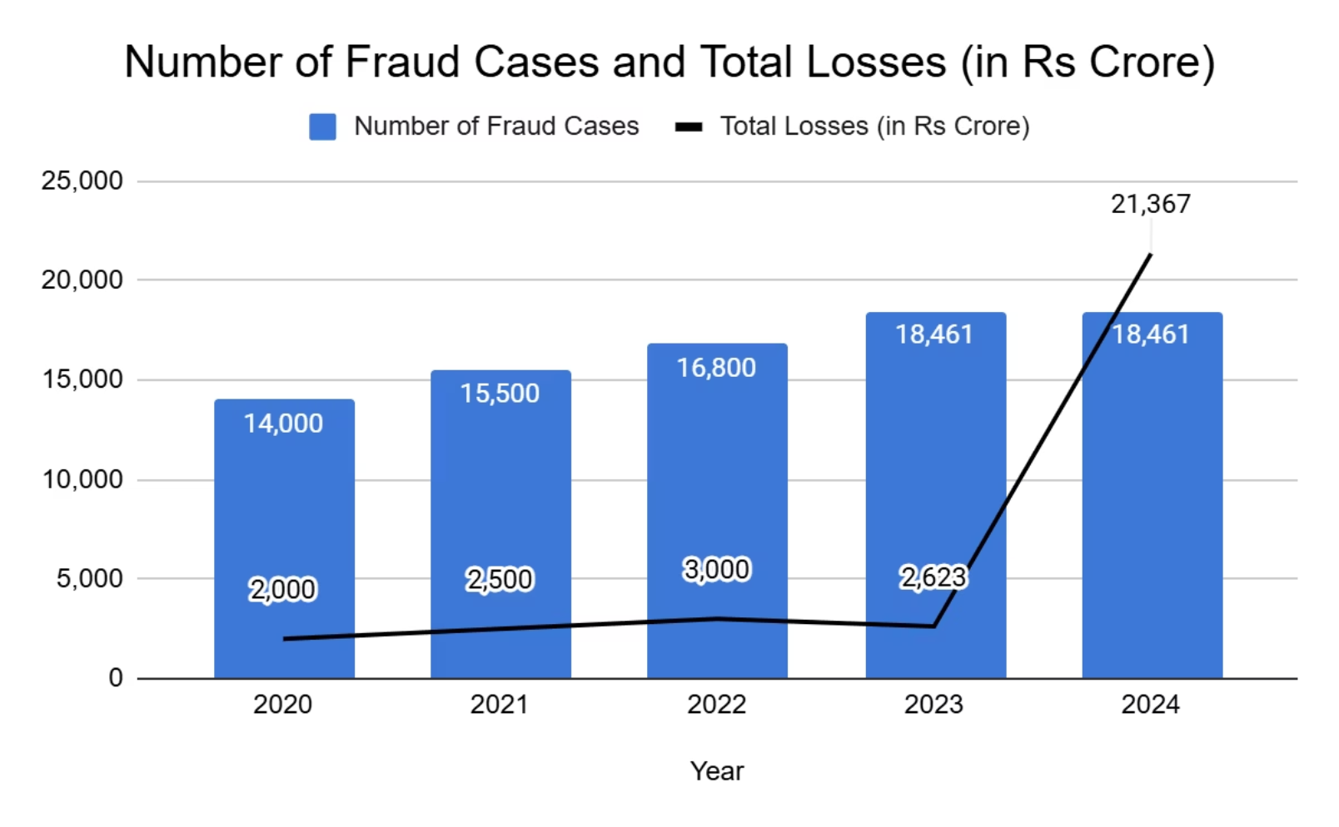

Introduction
The Challenge
Fraud detection is a critical process that identifies scams and prevents fraudsters from obtaining money through deceptive means. It represents a serious business risk requiring immediate identification and mitigation.
Financial fraud costs the banking sector billions annually, making predictive detection systems essential for operational security.

Slide 4
Project Methodology & Results
Objective
Develop a robust machine learning model to predict online payment fraud for enhanced security and risk management.
Data Collection & Processing
1
Comprehensive transaction data analysis with statistical verification, missing value assessment, and data type validation across customer payment records.
2
Exploratory Data Analysis
Performed univariate, bivariate, and multivariate analysis to understand transaction patterns, correlation relationships, and feature interactions.
Feature Engineering
3
Applied one-hot encoding to categorical variables and prepared datasets for machine learning model training and optimization.
4
Model Development
Trained four algorithms (Random Forest, Decision Tree, XGBoost, Logistic Regression) using 70% training, 30% testing split with comprehensive performance evaluation.
Decision Tree achieved performance of 99.9% prediction accuracy with 86% recall and 90% precision, making it the recommended deployment model.

Slide 5
Advantages of Fraud Detection
Protect Assets
Safeguard financial resources and sensitive data from illicit activities.
Maintain Trust
Preserve customer and stakeholder confidence in financial systems.
Reduce Financial Losses
Minimize direct monetary impacts from fraudulent transactions and schemes.
Ensure Regulatory Compliance
Adhere to legal and industry standards, avoiding penalties and reputational damage.
Enhance Customer Experience
Provide secure and reliable services, boosting overall user satisfaction.

Slide 6





Model Architecture
Our fraud detection system follows a structured pipeline from data ingestion to model deployment.
Raw Data Acquisition
Kaggle Dataset
Exploratory Data Analysis (EDA)
In-depth examination of data to identify trends, anomalies, and relationships crucial for feature engineering.
Data Preprocessing
Cleaning, transformation, and normalization of data to ensure high quality and compatibility for machine learning models.
Train-Test Split
Dividing the preprocessed data into training and testing sets to objectively evaluate model performance and prevent overfitting.
Model Selection
Evaluation of multiple algorithms: Random Forest, Decision Tree, Logistic Regression, and XGBoost Classifiers.
Final Model Selection
Identifying the optimal model based on rigorous performance metrics, balancing accuracy, recall, and precision for robust detection.
Deployment
Integrating the chosen model into live systems for real-time fraud detection and continuous monitoring of financial transactions.

Slide 7
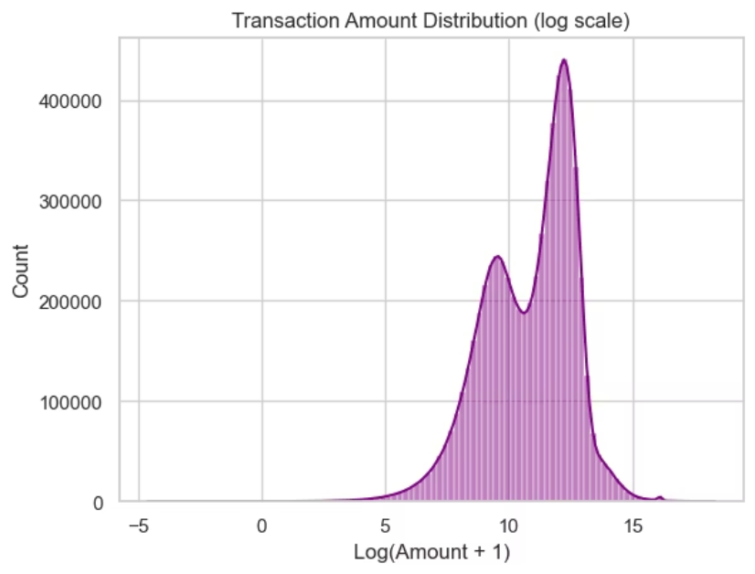
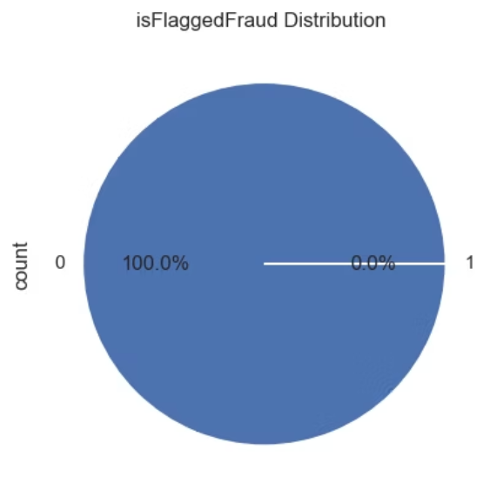
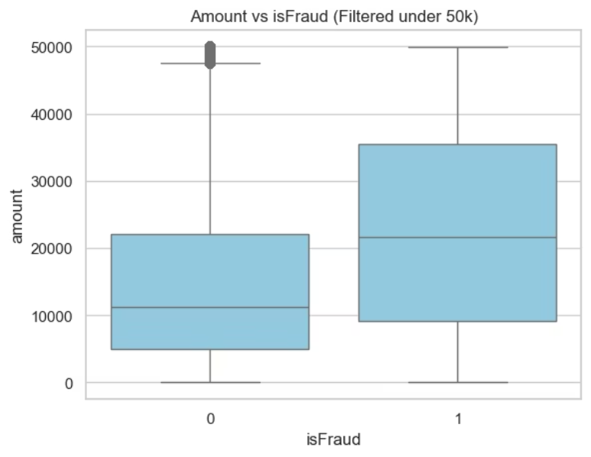
Data Exploration & EDA
The dataset used for this project contained 6 Million transaction with features such as Transaction Type, Steps, Transaction Amount, Old & New Balance and Fraud Amount
EDA revealed Key insights into transaction behavior, such as:
Our target column show Imbalanced data, only 0.1% are fraudster
There are two common transaction sizes: many transactions are in one small value range, and many are in a larger value range. There are fewer transactions in between. This means people make both small and large payments often, but medium amounts are less common
Fraud transactions under 50k have a notably higher median amount and wider spread than non-fraud ones, suggesting frauds attempt larger amounts on average

Slide 8
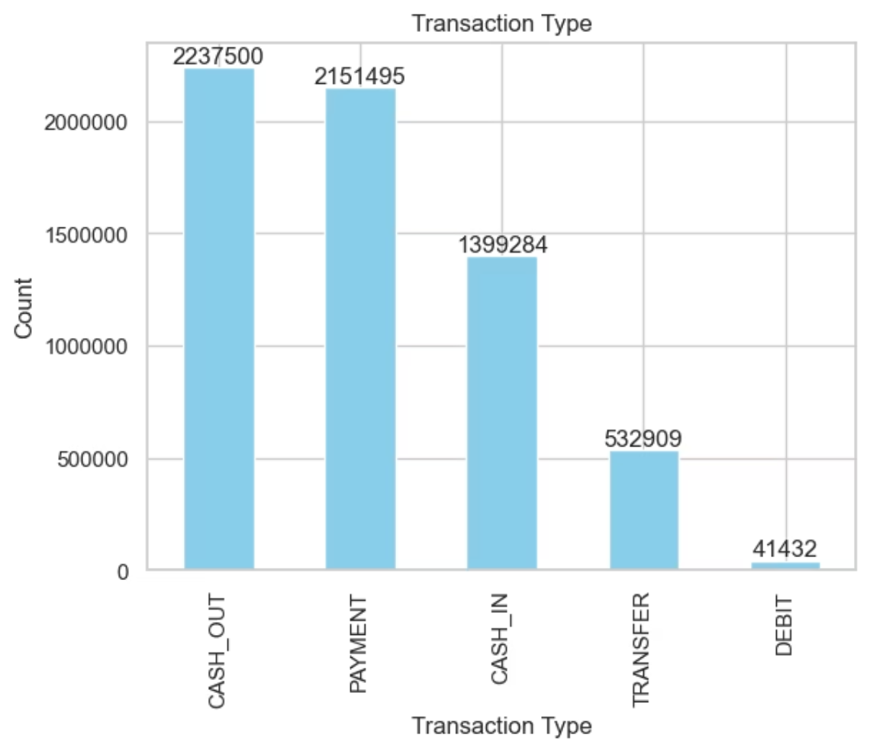
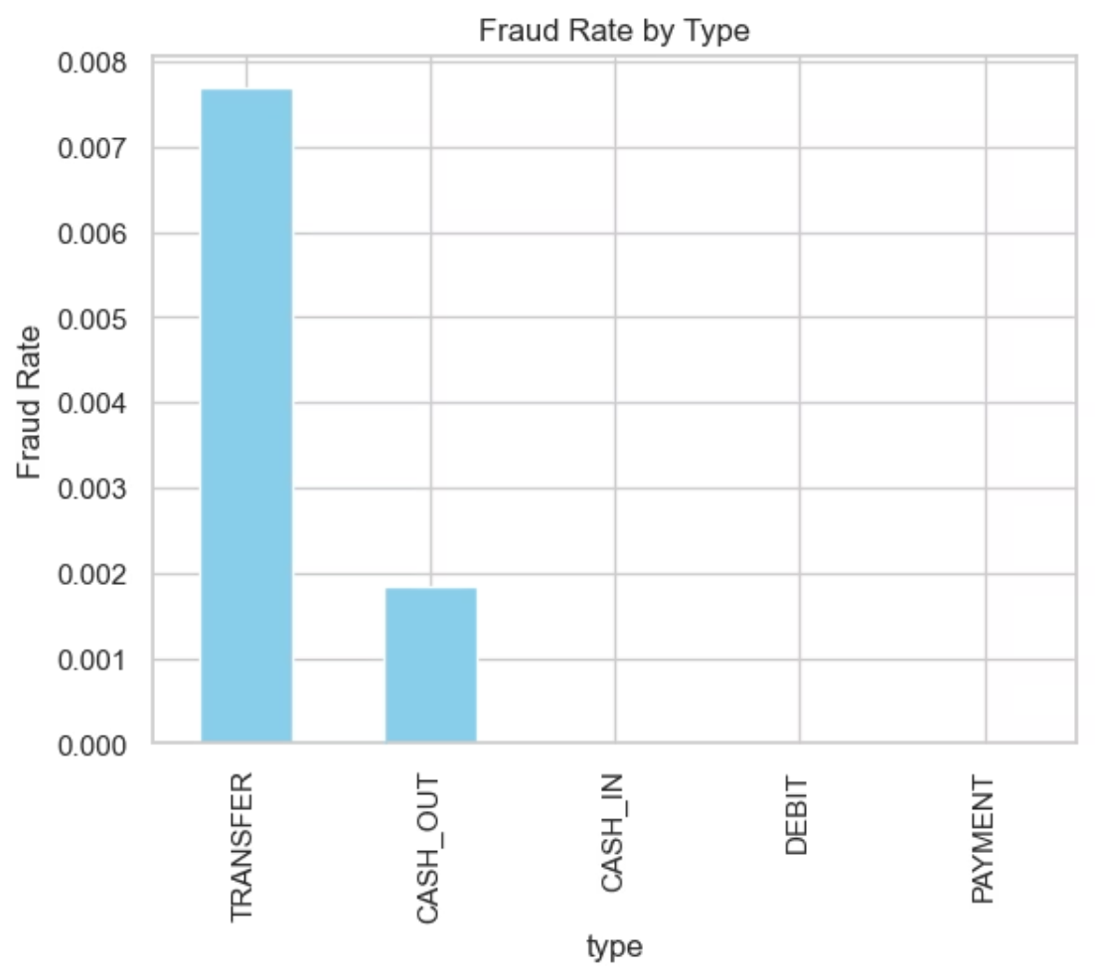
Analysis
Amount Analysis
Key Finding
The chart shows CASH_OUT and PAYMENT are the most common transaction types, while TRANSFER and DEBIT are much less frequent. This means most activity involves withdrawing money or making payments
Transfer and cash-out transactions contain the highest concentration of fraudulent activities, requiring enhanced monitoring protocols.
Fraudsters mainly target fund transfers and cash withdrawals, making these types most vulnerable to fraud activity

Slide 9
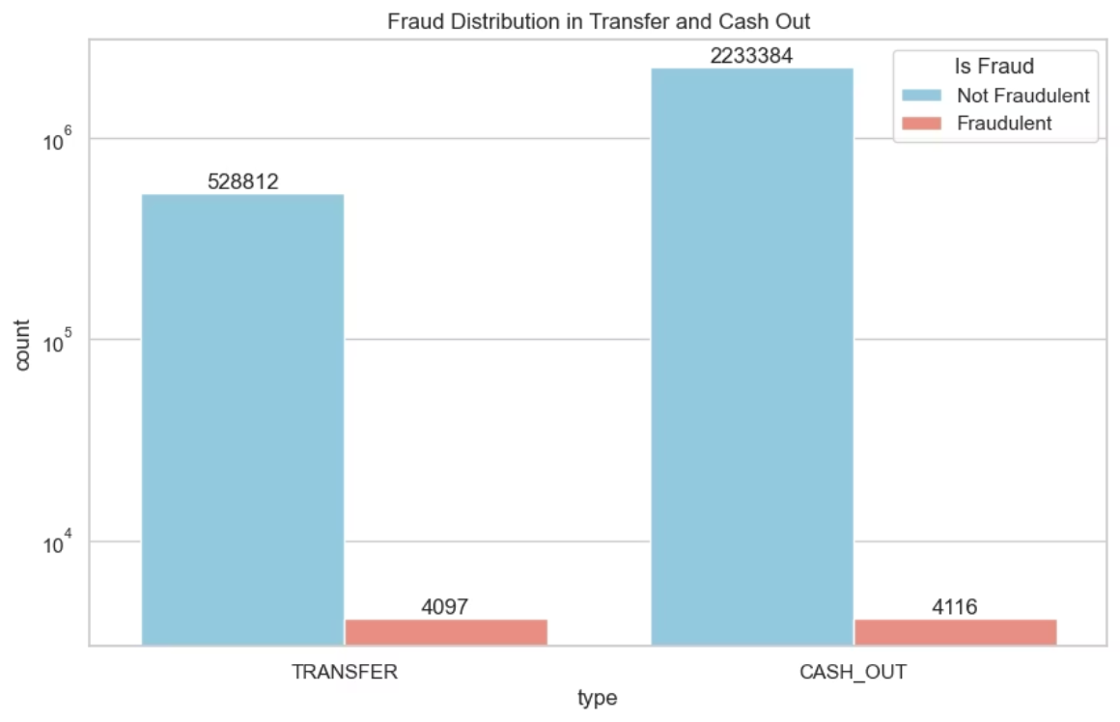
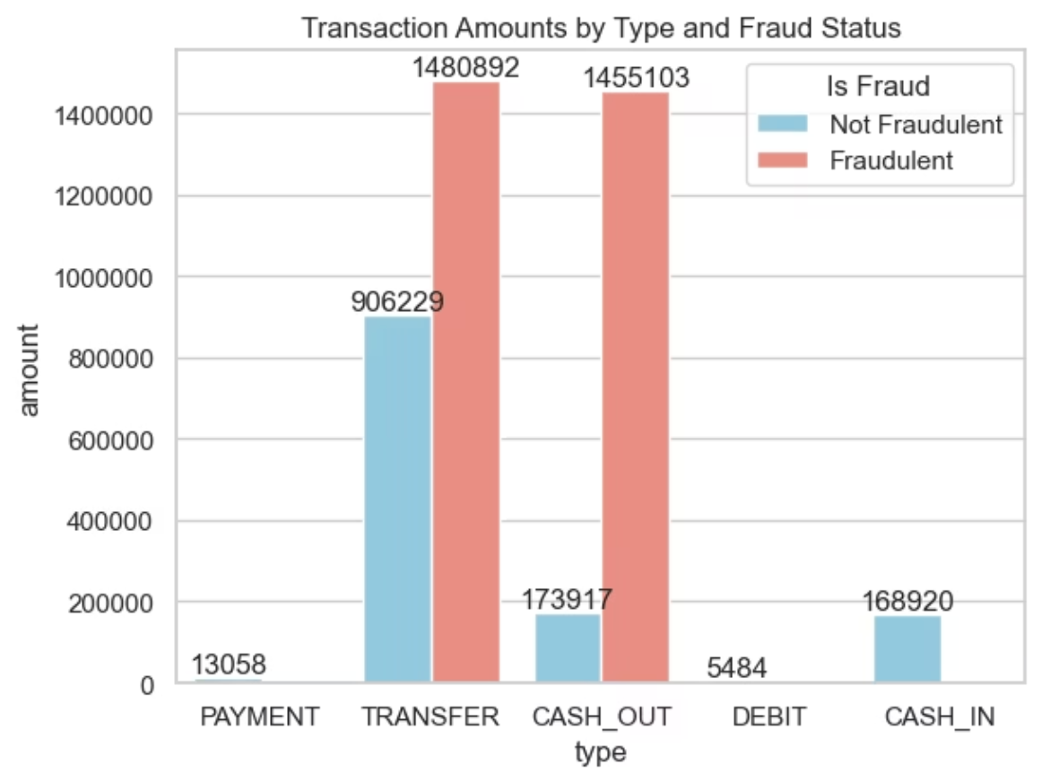
Analysis
Analysis
Key Insights
the number of fraudulent transactions is much smaller than non-fraudulent ones for both TRANSFER and CASH_OUT types
Fraudulent transactions are highly concentrated in 'TRANSFER' (₹1,480,892) and 'CASH_OUT' (₹1,455,103) types, showing these are the primary channels targeted by fraudsters.
Legitimate 'TRANSFER' and 'CASH_OUT' transactions are much lower (₹906,229 and ₹173,917), confirming the need for stronger controls on these categories.

Slide 10

Analysis
Insight
Fraud transactions under 50k have a notably higher median amount and wider spread than non-fraud ones, suggesting frauds attempt larger amounts on average,

Slide 11
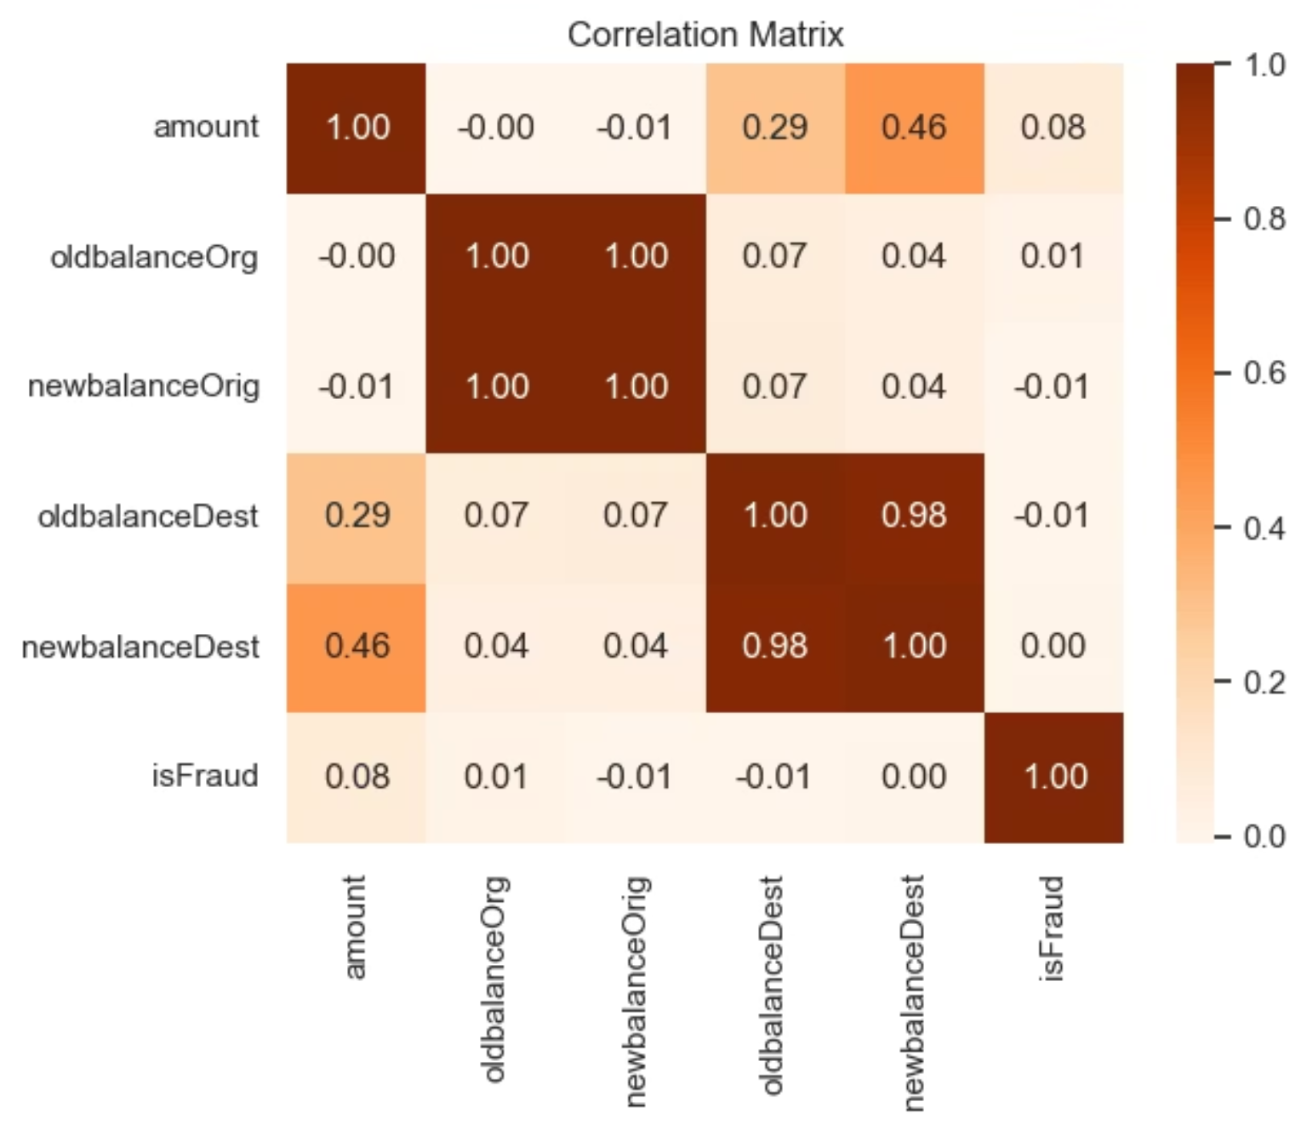
Correlation Matrix Plot
This correlation matrix visualizes the relationships between different numerical features in the dataset that are strongly associated with fraud transaction.
The amount and newbalanceDest columns show a moderate positive correlation (r=0.46r=0.46), indicating transaction amount affects the new balance at destination.
oldbalanceDest and newbalanceDest are highly correlated (r=0.98r=0.98), reflecting their direct relationship in transactions.
isFraud has very weak correlation with all other numerical features (r≤0.08r≤0.08), suggesting simple linear relationships don’t predict fraud effectively.
The heatmap confirms low multicollinearity between most features (many r≈0r≈0), supporting feature independence for modeling

Slide 12

Best Model Performance on Different Condition
Various ML models were evaluated to select the most effective approach for fraud detection.
ML models : [ 'XGBoost Classifier', 'Decision Tree Classifier', 'Logistic Regression', 'Random Forest Classifier']
Models
Precision (Fraud)
Recall (Fraud)
F1-Score (Fraud)
Logistic Regression
0.02
0.94
0.04
Decision Tree
0.90
0.86
0.88
XGBoost
0.83
0.72
0.77
SGDClassifier
0.02
0.90
0.03
Model Selection: Decision Tree model demonstrates superior performance with highest F1-score, ensuring optimal balance between precision and recall for fraud detection.

Slide 13
Answering Business Questions
What is the model's precision and accuracy in detecting fraudulent transactions?
Decision Tree Classifier, the model achieved precision of 90% and accuracy of 99.9% in detecting fraudulent transactions
How reliable is the model in classifying a transaction as legitimate or fraudulent?
The model is highly reliable, as it consistently achieves strong precision and recall, accurately distinguishing between legitimate and fraudulent transactions with a balanced approach.

Slide 14
Answering Business Questions
What are the potential losses due to model errors?
Potential losses due to model errors include:
Financial loss from missed frauds (false negatives): If the model fails to detect fraudulent transactions, these can result in direct financial losses, regulatory penalties, and reputational damage.
Operational cost from false alarms (false positives): Incorrectly flagging legitimate transactions can increase investigation workload, disrupt customer experience, and lead to unnecessary manual reviews or blocked accounts.
Customer dissatisfaction: Frequent mistakes can harm customer trust, reducing loyalty and potentially driving clients away.
Compliance risks: Failure to identify or properly handle fraud may result in non-compliance with banking regulations, exposing the institution to fines and legal action.
Each error type can affect both revenue and customer relationships in banking and fraud management settings.

Slide 15

Conclusion & Key Insights
Our comprehensive analysis and model development provide critical insights into effective financial fraud detection.
Targeted Fraud Prevention
Fraud is predominantly concentrated in 'TRANSFER' and 'CASH_OUT' transactions, which are now critical areas for enhanced monitoring.
High Model Accuracy
The Decision Tree Classifier achieves an impressive 90% precision and 99.9% accuracy, ensuring reliable fraud identification.
Minimized Financial Risk
The model effectively balances precision and recall, significantly reducing potential financial losses from undetected fraud (false negatives).
Operational Efficiency
By accurately distinguishing legitimate transactions, the model lowers operational costs associated with false alarms and improves customer satisfaction.

Slide 16


